Slide 1
Lecture – 20

Slide 2
Handling Cache Misses
Steps Taken on an Instruction Cache Miss:
Send the original PC value (PC-4) to the memory.
Instruct main memory to perform a read and wait for the memory to complete it’s access.
Write the cache entry, putting the data from memory in the data portion of the entry, writing the upper bits of the address into the tag field, and turning the valid bit on.
Restart the instruction execution at the first step, which will refetch the instruction, this time finding it in cache.

Slide 3
Handling Writes
Write Through:
Writes always update both the cache and the memory, ensuring that data is always consistent between two.
Memory write operation will take longer time and slow down the processor.
Let CPI is 1.0 without cache miss and about 10% of the instruction is store and every write require 100 clock cycle, then CPI = 1.0 + 100 * 10% = 11.
Solution to this problem is write buffer.

Slide 4
Handling Writes
Write buffer:
Write buffer stores data while it is waiting to be written to memory.
After writing the data into the cache and into the write buffer, the processor can continue execution.
When a write to main memory completes, the entry in the write buffer is freed.
The processor must stall for the write buffer to become empty.
If the rate of generating write by the processor is larger than the rate at which the memory can accept, then it will create problem.

Slide 5
Handling Writes
Write Back:
It handles write by updating values only to the block in the cache, then writing the modified block to the lower level of the hierarchy when the block is replaced.
It improves performance.
Implementation is difficult.

Slide 6
Designing Memory System to Support Cache
We can reduce the miss penalty by Increasing the memory bandwidth.
The clock rate of the bus is usually much slower than the processor, by as much as a factor of 10. The speed of this affects the miss penalty.
Assume the following memory access time:
1 memory bus clock cycle to send the address.
15 memory bus clock cycles for each DRAM access initiated.
1 memory bus clock cycle to send a word of data.

Slide 7
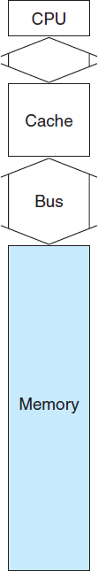
One-Word-Wide Memory Organization
Suppose,
Cache block = 4 words. Memory width = 1 word.
Then,
Miss penalty = 1+4*15+4*1 = 65 memory bus clock cycles.
The number of bytes transferred per bus clock cycle for a single miss = 4*4/65 = 0.25

Slide 8
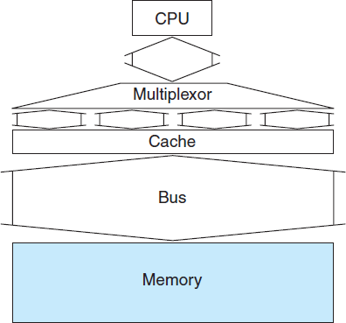
Wide Memory Organization
Suppose,
Cache block = 4 words. Memory width = 2 words.
Then,
Miss penalty = 1+2*15+2*1 = 33 memory bus clock cycles.
The number of bytes transferred per bus clock cycle for a single miss = 4*4/33 = 0.48

Slide 9
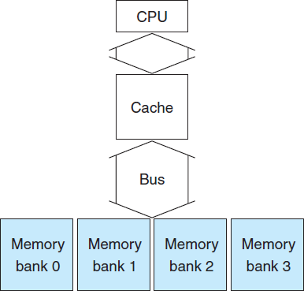
Interleaved Memory Organization
Suppose,
Cache block = 4 words. Memory width = 4 words.
Then,
Miss penalty = 1+1*15+4*1 = 20 memory bus clock cycles.
The number of bytes transferred per bus clock cycle for a single miss = 4*4/20 = 0.80
It also improves write miss.

Slide 10
Reducing Cache Misses
Two ways:
Fully associative cache
Set associative cache

Slide 11
Fully Associative Cache
A memory block can be placed in any location in the cache.
To find a given block all the entries in the cache must be searched.
A comparator is associated with each cache entry increasing the hardware cost.
This placement is practical only for caches with small number of blocks.

Slide 12
Set Associative Cache
There are a fixed number of locations where each block can be placed.
A set-associative cache with n locations for a block is called an n-way set associative cache.
A n-way set associative cache consists of a number of sets, each of which consists of n blocks.
Each block in the memory maps to a unique set in the cache given by the index field and a block can be placed in any elements of the set.

Slide 13
Set Associative Cache
In combines both direct mapping and fully associative placement. A block is directly mapped into a set, and then all the blocks in the set are searched for a match.
Set number = (Block number) modulo (Number of sets in the cache).
The advantage of increasing the degree of associativity is that it usually decreases the miss rate.
The main disadvantage is it increases the hit time.

Slide 14
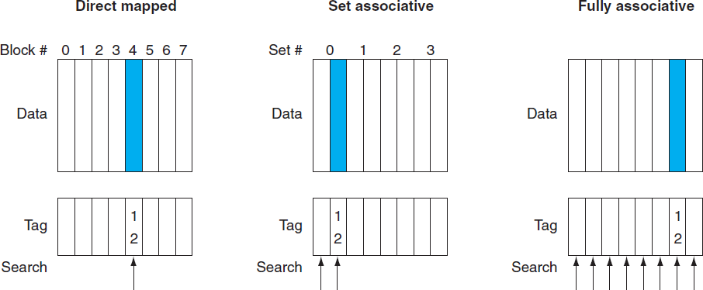
Memory Block Mapping in the Cache

Slide 15
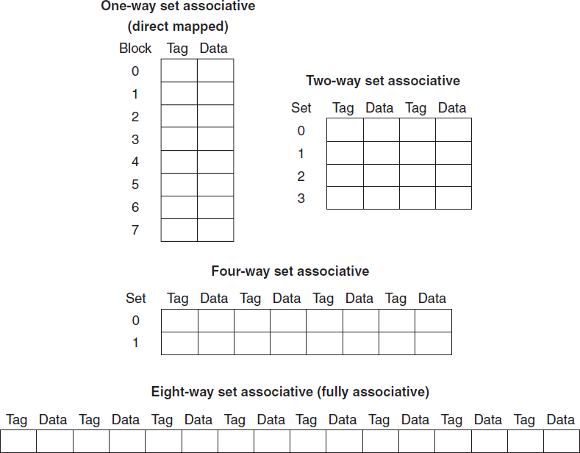
Cache Configuration

Slide 16
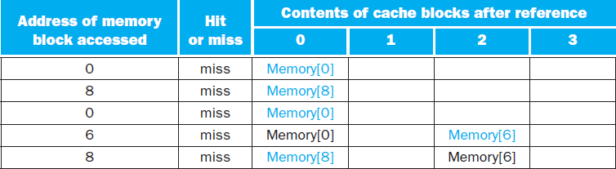
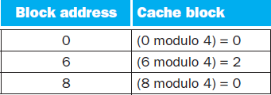
Memory Accesses in Cache
Cache size = four one-word blocks.
Block addresses = 0, 8, 0, 6, 8
Direct Mapped Cache:
Five misses for five accesses.

Slide 17
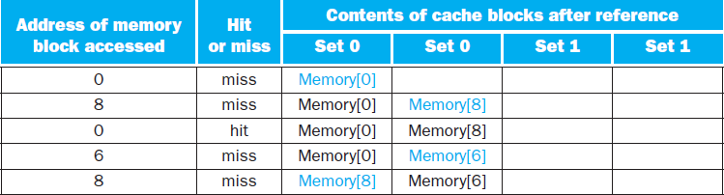
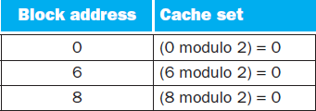
Memory Accesses in Cache
Two Way Set Associative:
Four misses on five accesses

Slide 18
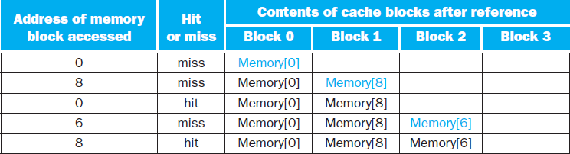
Memory Accesses in Cache
Fully Associative Cache:
Three misses on five memory accesses

Slide 19
Memory Accesses in Cache
Here, it shows that fully associative is best.
If we had eight blocks in the cache, there would be no replacements in the two-way set-associative cache, and it would have the same number of misses as the fully associative cache.
If we had 16 blocks, all three caches would have the same number of misses.
So, the cache size and associativity are not independent in determining cache performance.

Slide 20
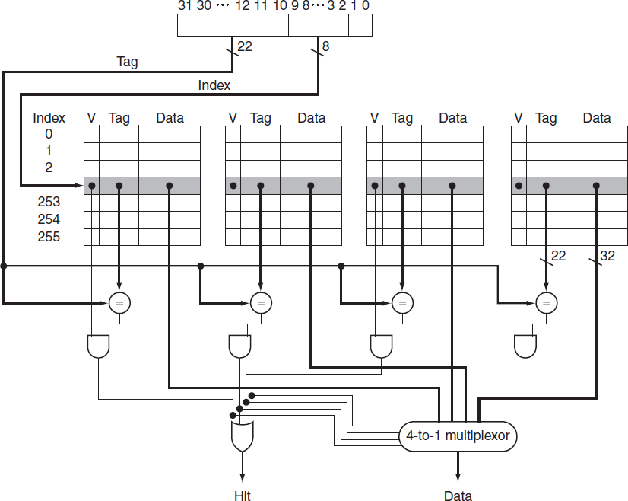
Implementation of Four-way Set Associative Cache

Slide 21
Size of Tag
Cache size = 4K blocks
Block size = 4 words
Address = 32 bits
Direct mapped cache:
Number of sets = 4K
Index = 12 bits
Number of tags=32-12-4= 16 bits

Slide 22
Size of Tag
Two way Set Associative:
Number of sets = 4K/2 = 2K
Index = 11 bits.
Tag = 32-11-4 =17 bits
Four way Set Associative:
Number of sets = 1K
Index = 10 bits
Tag = 32-10-4 =18 bits

Slide 23
Size of Tag
Fully Associative:
Number of sets = 1
Index = 0 bit
Tag = 32-0-4 = 28 bits

Slide 24
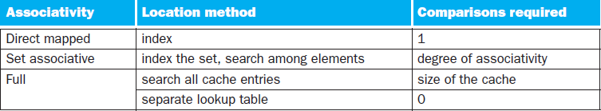
Locating a Block

Slide 25
Block Placement
Random Selection
Least Recently Used (LRU)

Slide 26
Three Sources of Misses
Compulsory Misses:
Caused by the first access to a block that has never been in the cache.
Capacity Misses:
Caused when the cache cannot contain all the blocks needed during execution of a program.
Conflict Misses/ Collision Misses:
When multiple blocks compete for the same location (direct mapping) or same set (set associative).

Slide 27
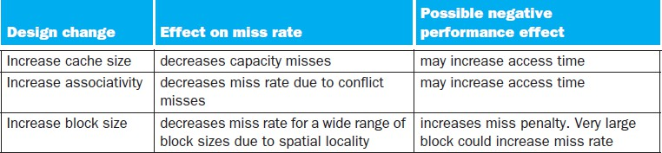
Solutions

